Slide 1
SC1015 Project
Predicting stock prices
ECAD 1
Ho Wei Hao
Lee Han Ni
Liaw Jia Xuan Celest

Slide 2
Table of contents
01
Introduction
02
Problem Definition
03
Data Preparation
04
Exploratory Data Analysis
05
Machine Learning
06
Insights

Slide 3
01
Introduction

Slide 4



Financial Hubs
Shanghai
Singapore
New York

Slide 5
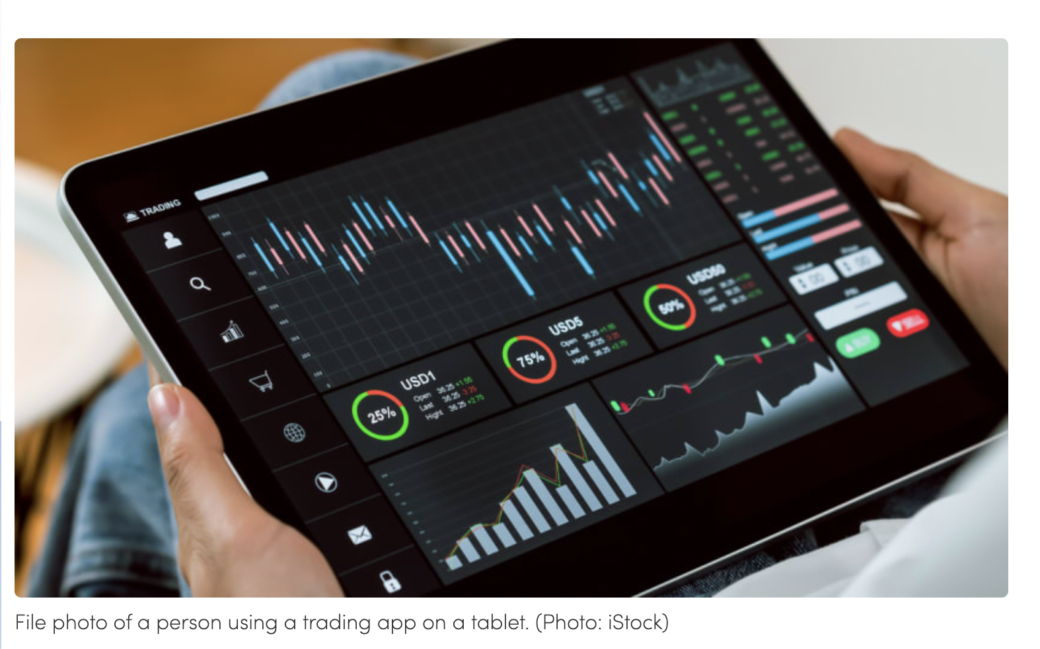
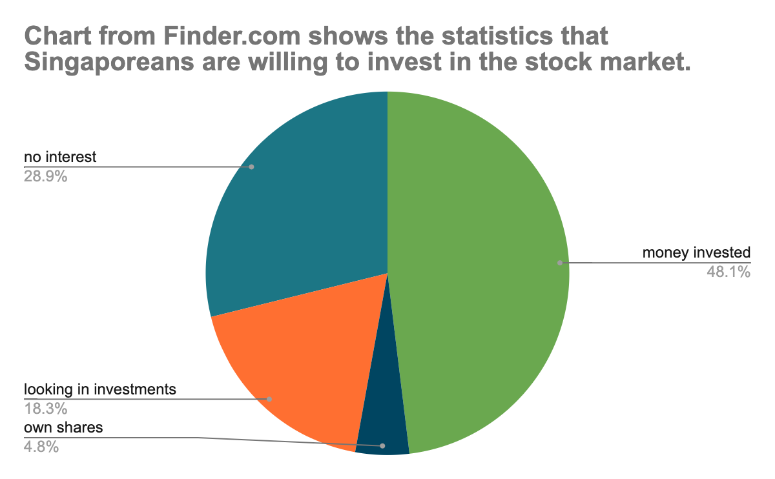
Motivation

Slide 6
02
Problem Definition
To what extent can we use various economic variables to predict trends in future stock prices?

Slide 7


Datasets used
Yahoofinancials
Alpha Vantage Stock API
Python Module providing stock data from Yahoo Finance
API providing economic indicators

Slide 8
03
Data Preparation

Slide 9










Stocks
MSFT
AMZN
FB
SPY
ADBE
GOOG
TSLA
NKE
DELL
HPQ

Slide 10
Economic Variables
Retail Sales
Unemployment
Inflation expectations
Federal Funds Rate
Consumer Sentiment

Slide 11
Removing Unnecessary Data
We removed the variables in the red box as it was not needed.

Slide 12
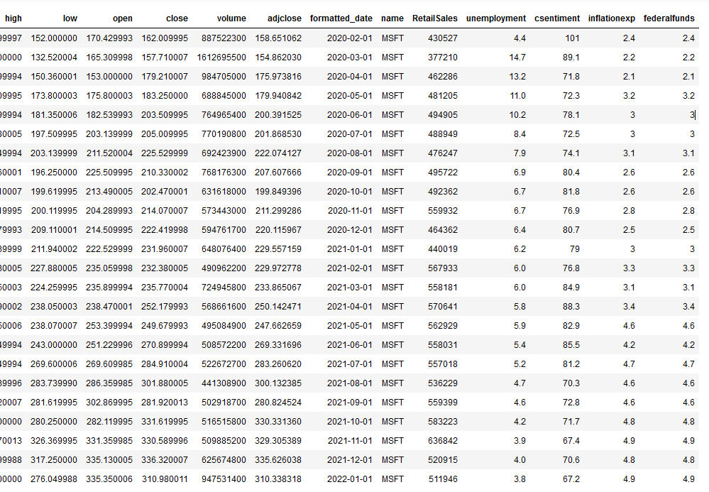
Merging Datasets

Slide 13
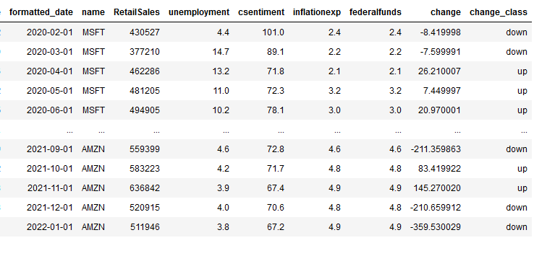
Reformatting Data

Slide 14
04
Exploratory Data Analysis

Slide 15
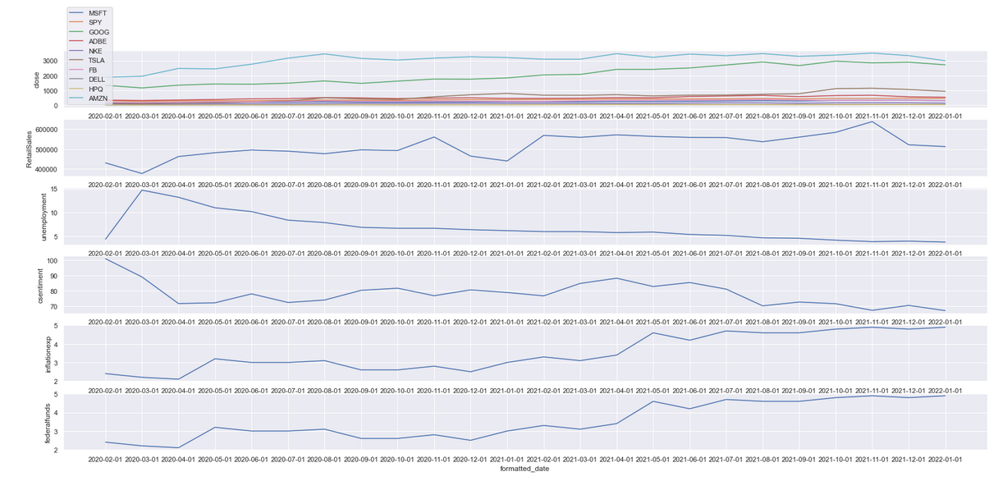
Time Series NEW!
Similar trends observed between closing price of stock and variables like retail sales, inflation expectations and federal funds.

Slide 16
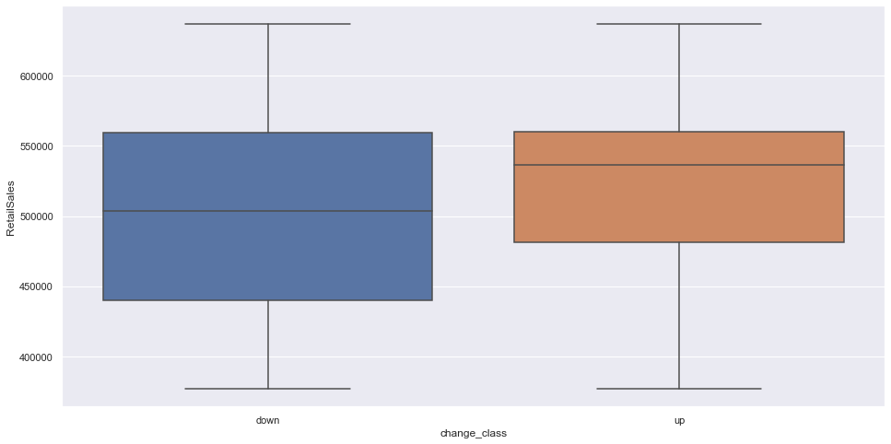
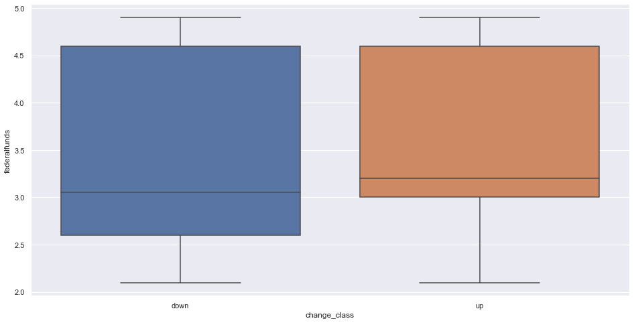
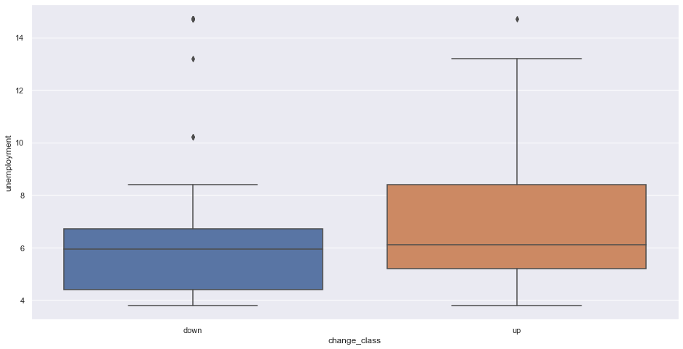
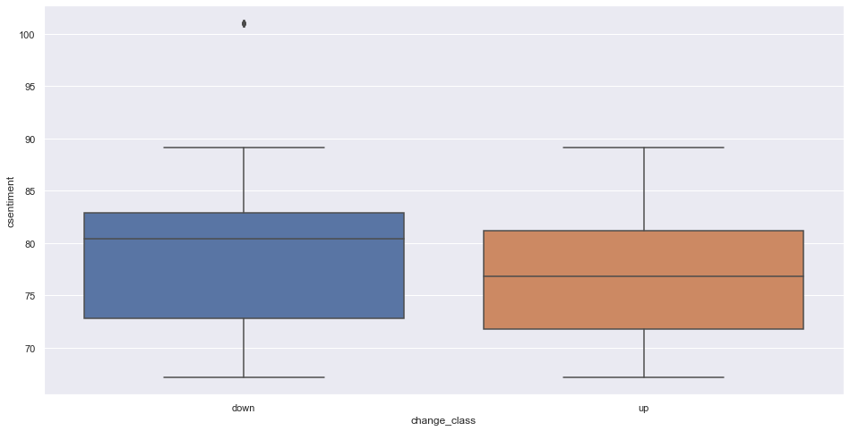

Boxplot
Retail Sales
Federal Funds
Unemployment
Consumer Sentiments
Inflation expectations
Retail Sales and Unemployment may be better predictors as compared to the others, as they result in the most significant difference in shape of the boxplot.

Slide 17
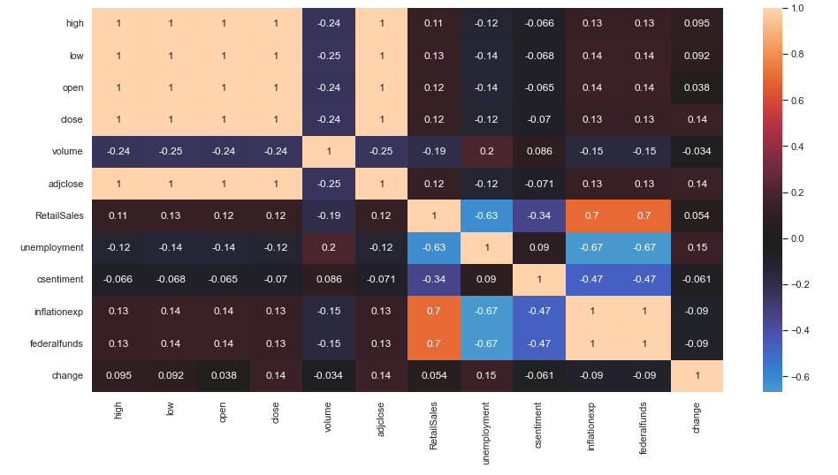
Heatmap
Unemployment has the highest value = most correlated,
followed by Retail Sales

Slide 18
05
Predicting with ML models

Slide 19
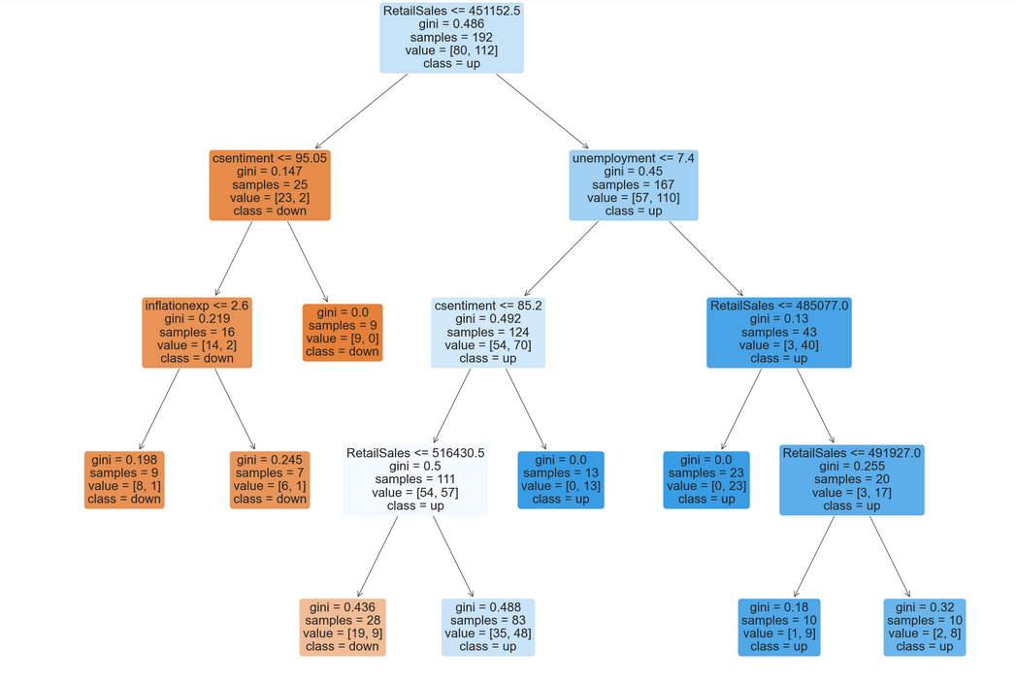
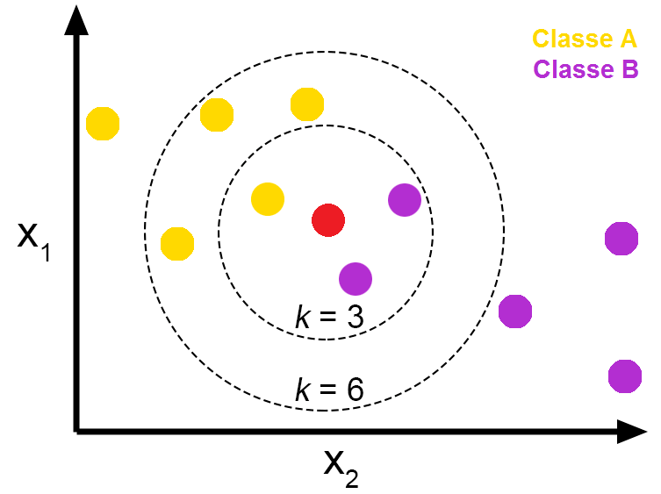
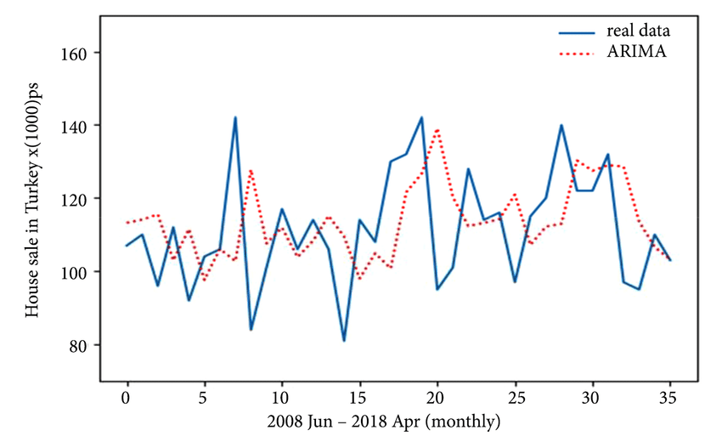
Machine Learning Models
Decision Tree
K-Nearest Neighbour
ARIMA
NEW!
NEW!

Slide 20
Decision Tree Learning
Supervised learning method
Binary classification with decision tree where partitions are represented using consecutive binary decisions.
Decisions of partition depends on the gini index – a lower gini value tells us that a lower proportion of a particular variable is classified wrongly

Slide 21
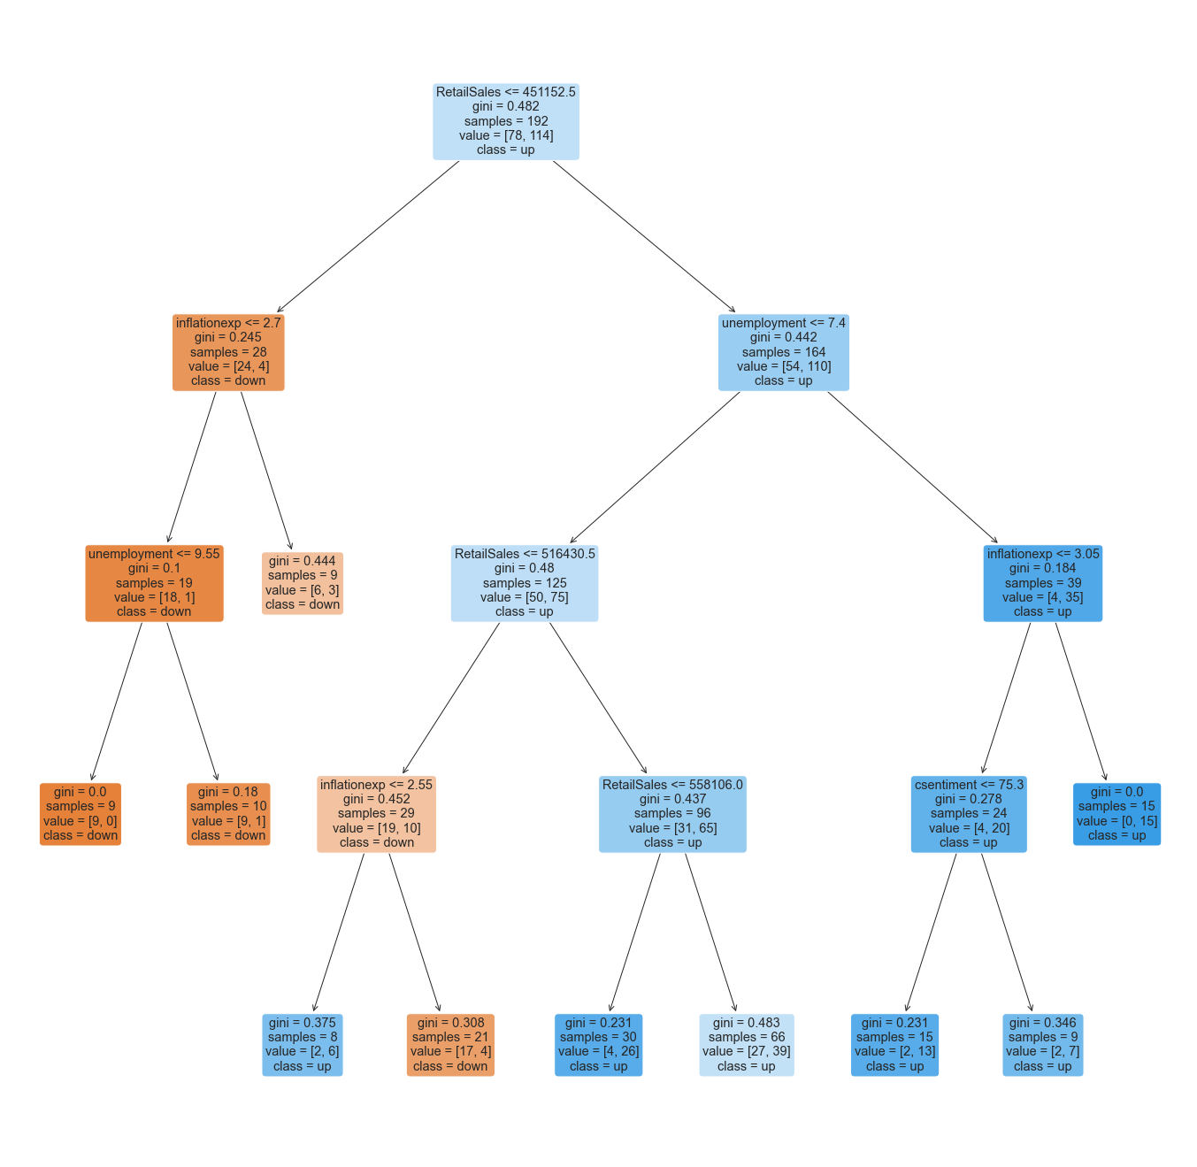
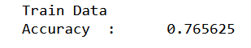
Ranking of predictors
Retail Sales
Inflation expectation
Unemployment
Consumer Sentiment

Slide 22
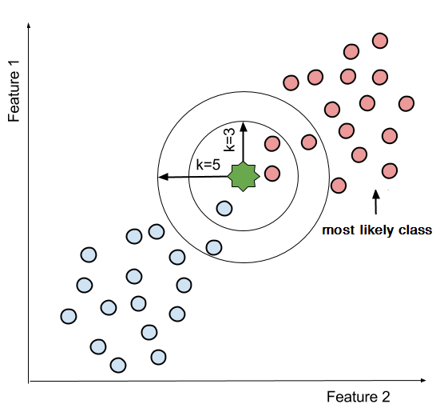
K-Nearest Neighbours (KNN)
Supervised learning method
Takes the majority in K number of neighbours to determine the type of a certain data point
Optimal K value has the lowest misclassification error

Slide 23
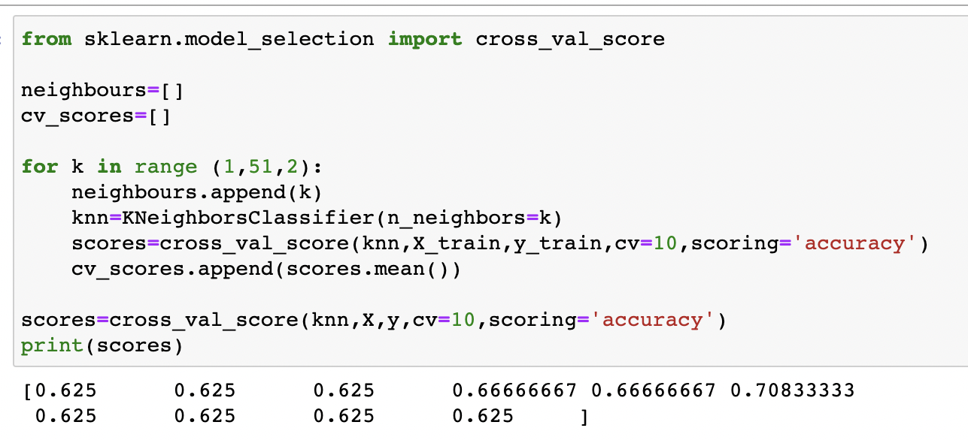
Cross-Validation
Select the cross-validation dataset by taking a small portion from the training dataset and then use the same to evaluate different possible values of K by performing 10 fold cross-validation

Slide 24
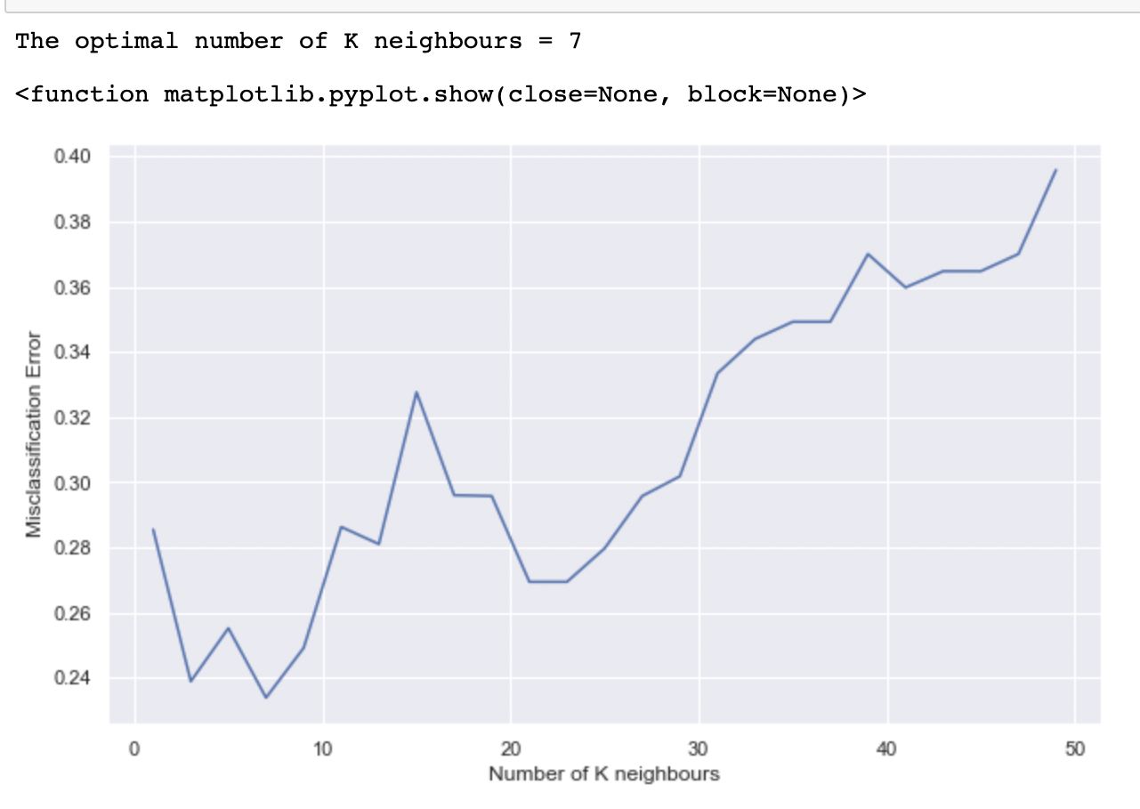
Choosing the optimal K value
Optimal K value = 7

Slide 25
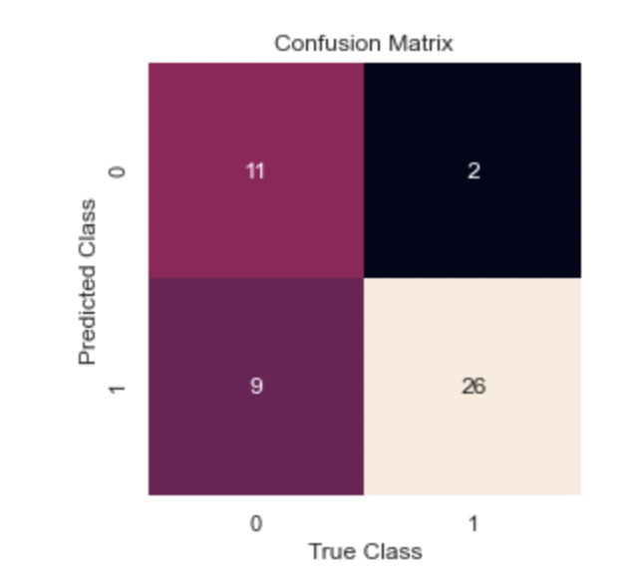
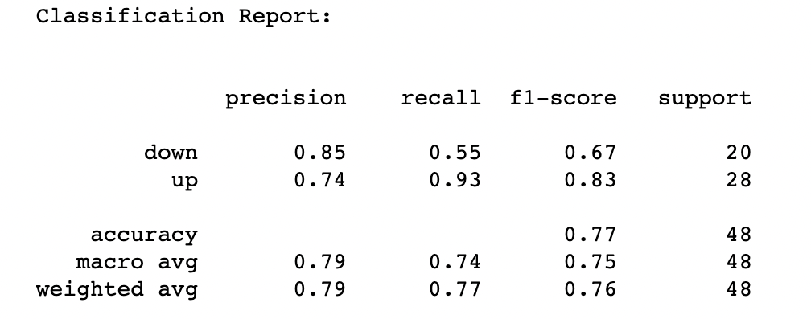
Evaluating KNN
Representation of the main classification metrics on a per-class basis.
Gives a deeper intuition of the classifier behavior over global accuracy which can mask functional weaknesses in one class of a multiclass problem.
Accuracy = 0.77083
Gives a clear overview of the actual labels and the prediction of the model.
Represents the accuracy visualization of the predicted model looking at the True Negative and True Positive.

Slide 26
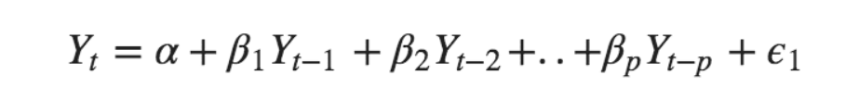
ARIMA
Similar to Linear Regression, but uses past data points as predictors.
Predictors
(Past values)
Predicted Value
Residual Error

Slide 27
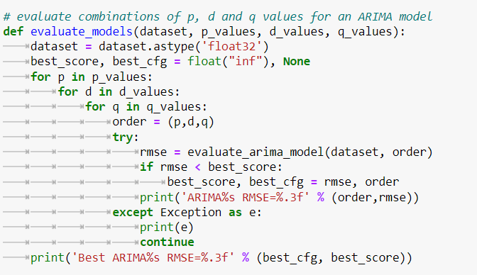
3 parameters to vary:
We used the values of P, D, and Q that corresponds with the lowest RMSE for the model.
P Number of lag(previous) observations to be used.
D Number of differences needed for stationarity.
Q Number of lagged forecast errors to be used.
Notes:
‘p’ is the order of the ‘Auto Regressive’ (AR) term. It refers to the number of lags of Y to be used as predictors. And ‘q’ is the order of the ‘Moving Average’ (MA) term. It refers to the number of lagged forecast errors that should go into the ARIMA Model.

Slide 28
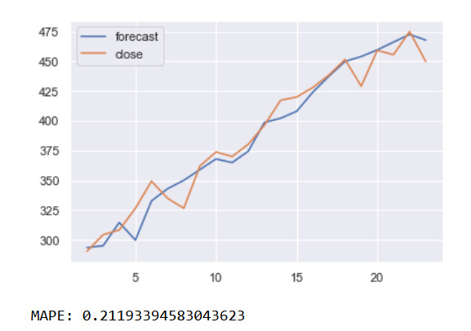
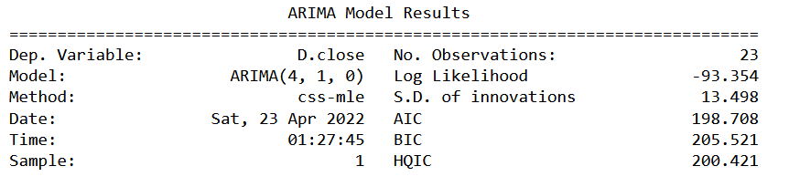
Evaluating ARIMA
AIC (Akaike Information Criteria) : Quantifies the model’s goodness of fit. (The lower the better!)
MAPE (Mean Absolute Percentage Error): Indicates the inaccuracy of the model.
Fitting the model
(actual vs forecasted)

Slide 29
Comparing the Models
76.6%
77.1%
78.7%
Decision Tree
K Nearest Neighbour
ARIMA

Slide 30
Best Model: ARIMA

Slide 31
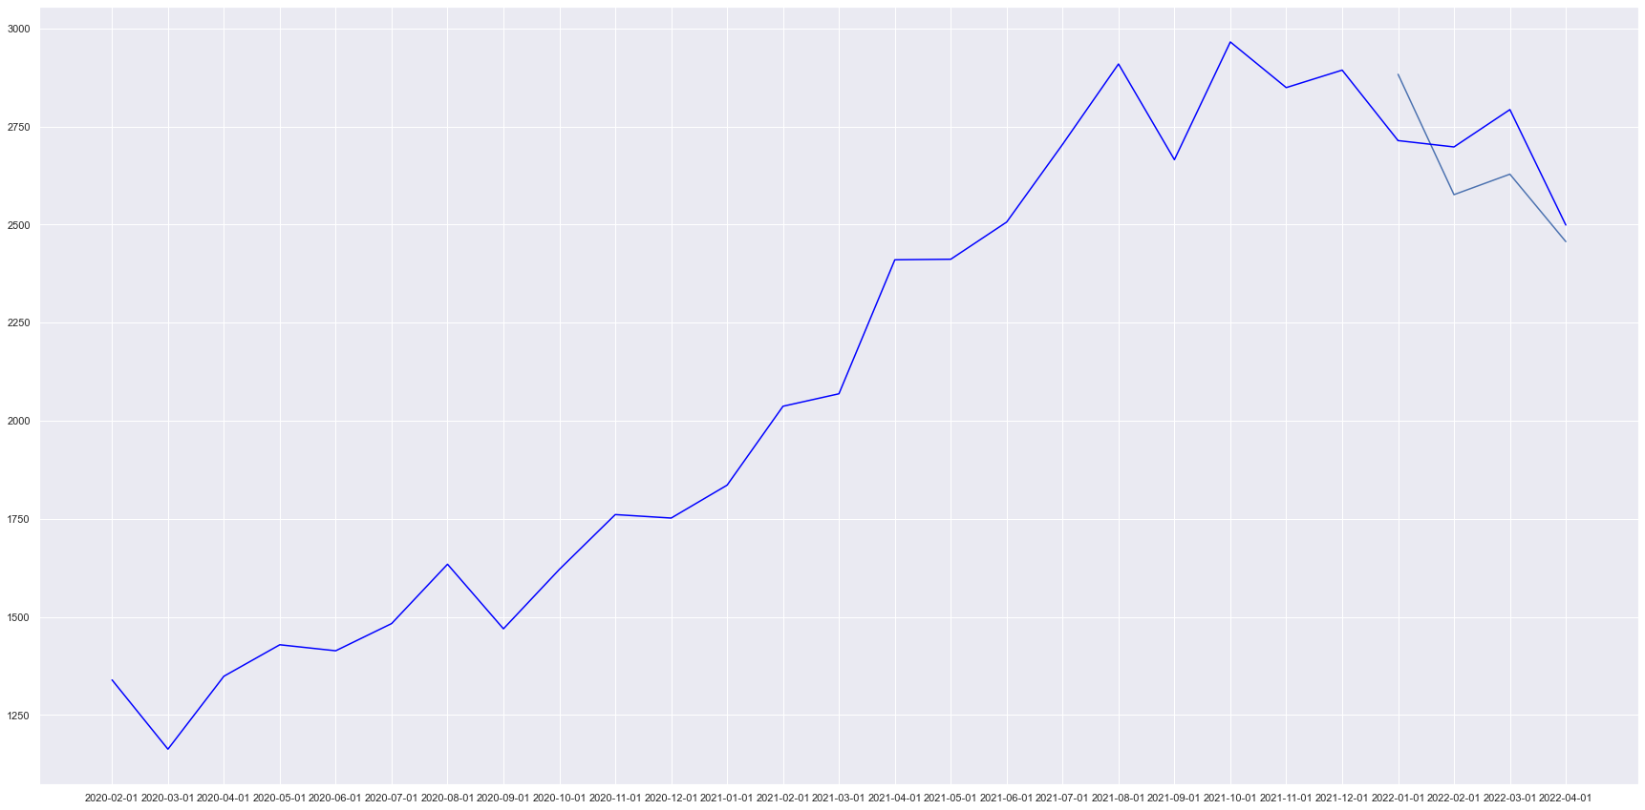
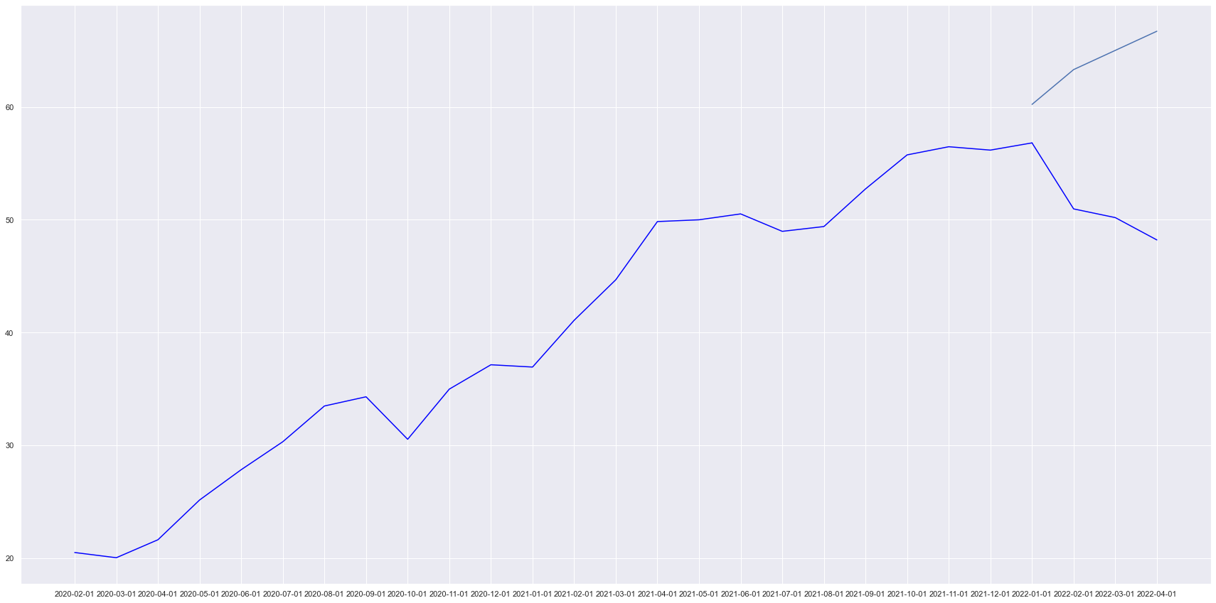
Forecasting with Arima
Using ARIMA model with optimal parameters to predict price of next 3 months(our test set), vs the actual prices.
Stock: Google
Accurate!
(Smaller Errors + Identical direction)
Stock: Dell
Less Accurate!
(Larger Errors + Different direction)

Slide 32
06
Insights

Slide 33
Outcome
Investors can use our machine learning models to make more informed decisions before investing.
They can also switch up the economic variables to others that may have a greater impact on stock prices due to various economic circumstances.

Slide 34
Data-driven Insights
Some of the stocks had similar predicted trends, though most have different stock prices from the predicted.
Unreliable to fully rely on these models to predict stock prices, but can be used as a guide to observe trend.
While stock price movement is still largely random, using economic indicators that have some relation to stock prices as well as past price movements can help us make slightly more informed choices

Slide 35
Recommendation #1
Instead of just using ARIMA, we can also pair it with Decision Tree.
Decision Tree takes into account economic trends while ARIMA just uses past stock prices: both have its own merits, we can consult both tools to see if there is any relation.
ARIMA
Decision Tree

Slide 36
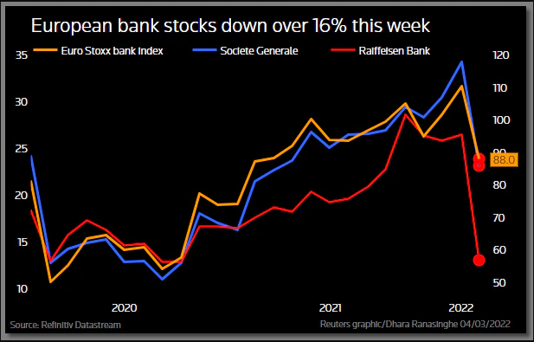
Recommendation #2
Should focus on predicting the volatility of an asset instead of its returns
Stock prices are susceptible to international happenings, just like how the recent Russian-Ukraine War has caused uncertainty and chaos in the stock market.
Stock market prices involve a lot of intangible factors such as people sentiment.

Slide 37
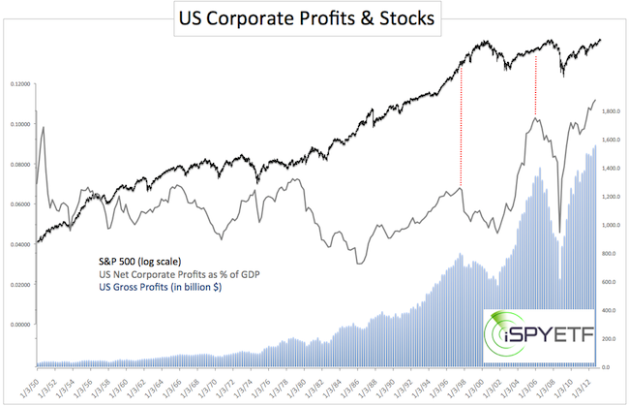
Recommendation #3
Consider using company’s financials as predictors of stock price.
E.g. positive earnings correlate with increase in stock prices.
Could potentially use these in tandem with our aforementioned economic variables.

